Slide 1

Metrik: Decentralized Credit Infrastructure
Metrik is a DeFi credit settlement platform revolutionizing B2B supply chain finance. We transform illiquid invoices into dynamic NFTs, bridging the gap between traditional trade and decentralized finance.

Slide 2

The Problem: Stifled Supply Chain Liquidity
Working Capital Gaps
Credit-based B2B transactions often lead to significant working capital gaps for suppliers.
Slow Settlements
Traditional invoice financing is slow, bureaucratic, and inefficient, hindering business growth.
Limited Access
Small and medium-sized enterprises (SMEs) frequently struggle to access affordable credit.

Slide 3
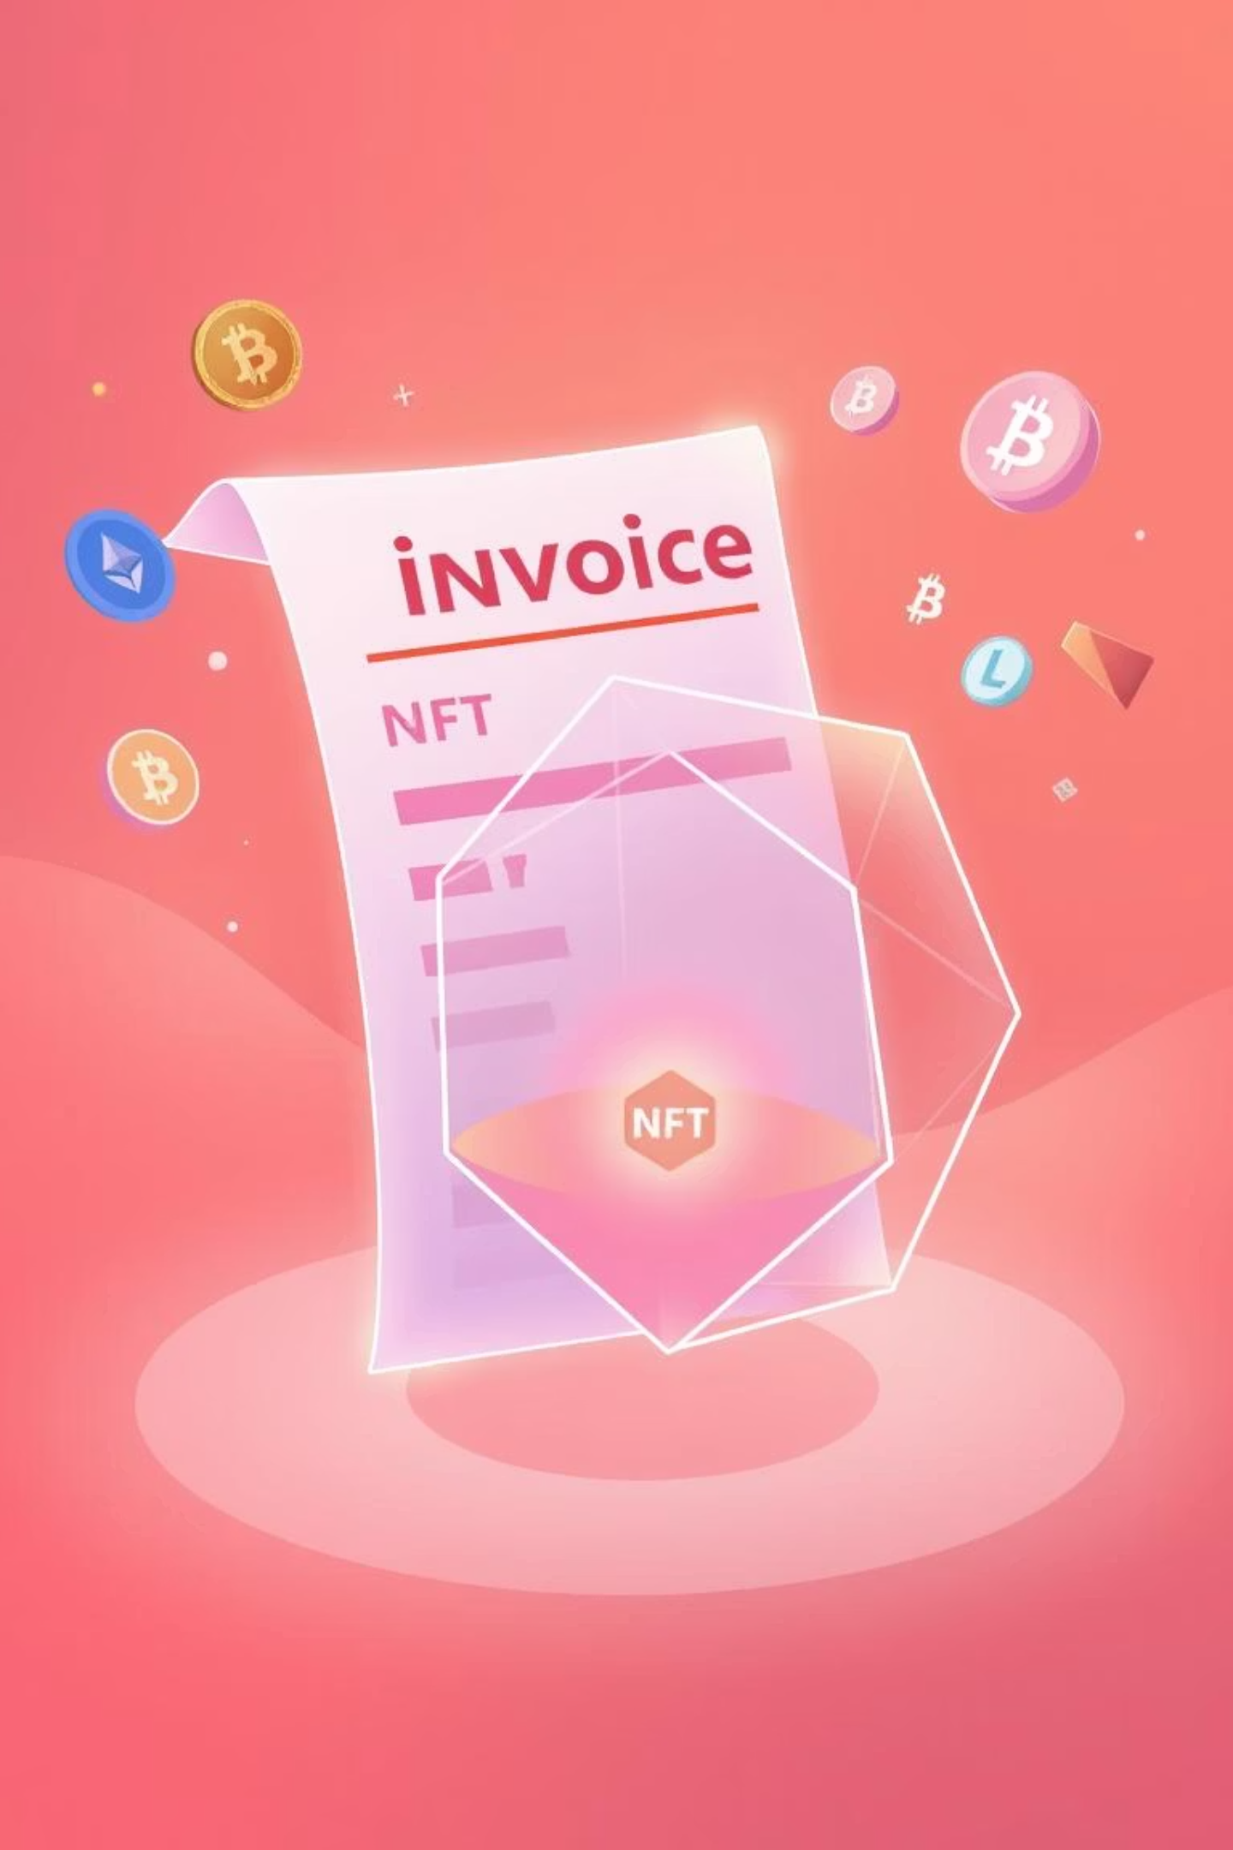




The Solution: Invoice-Backed DeFi Lending
Invoice Digitization
Invoices become expirable NFTs, representing verified proof-of-sale.
Crypto Liquidity Pools
Decentralized pools fund short-term credit needs instantly.
Instant Working Capital
Suppliers access funds immediately against their digitized invoices.
Automated Settlement
Smart contracts ensure seamless repayment and NFT expiration.

Slide 4

Vast Market Opportunity
The global supply chain finance market presents an immense opportunity for disruption through DeFi.
$52.23 B
$700B -$1.3T
500M+
Global Trade Finance Market Size
Addressable Market
Global SMEs
Estimated short-term credit volume for B2B transactions.
Potential users needing flexible working capital solutions.
Growing at a CAGR of 4.7% from 2025 to 2030

Slide 5
How It Works
Invoice Tokenization
Staking & Trust Scoring
Dynamic LTV Engine
Suppliers create expirable, verifiable NFTs representing invoices.
Suppliers stake $METRIK tokens to earn trust tiers, which define borrowing limits.
Metrik calculates borrowing capacity using on-chain staking, tier, and credit history.
Liquidity Matching
Repayment or Liquidation
Liquidity providers deposit USDC into pools and earn APR from borrowing activity.
Borrowers repay with interest; if overdue, NFTs are burned and staked tokens are slashed.

Slide 6
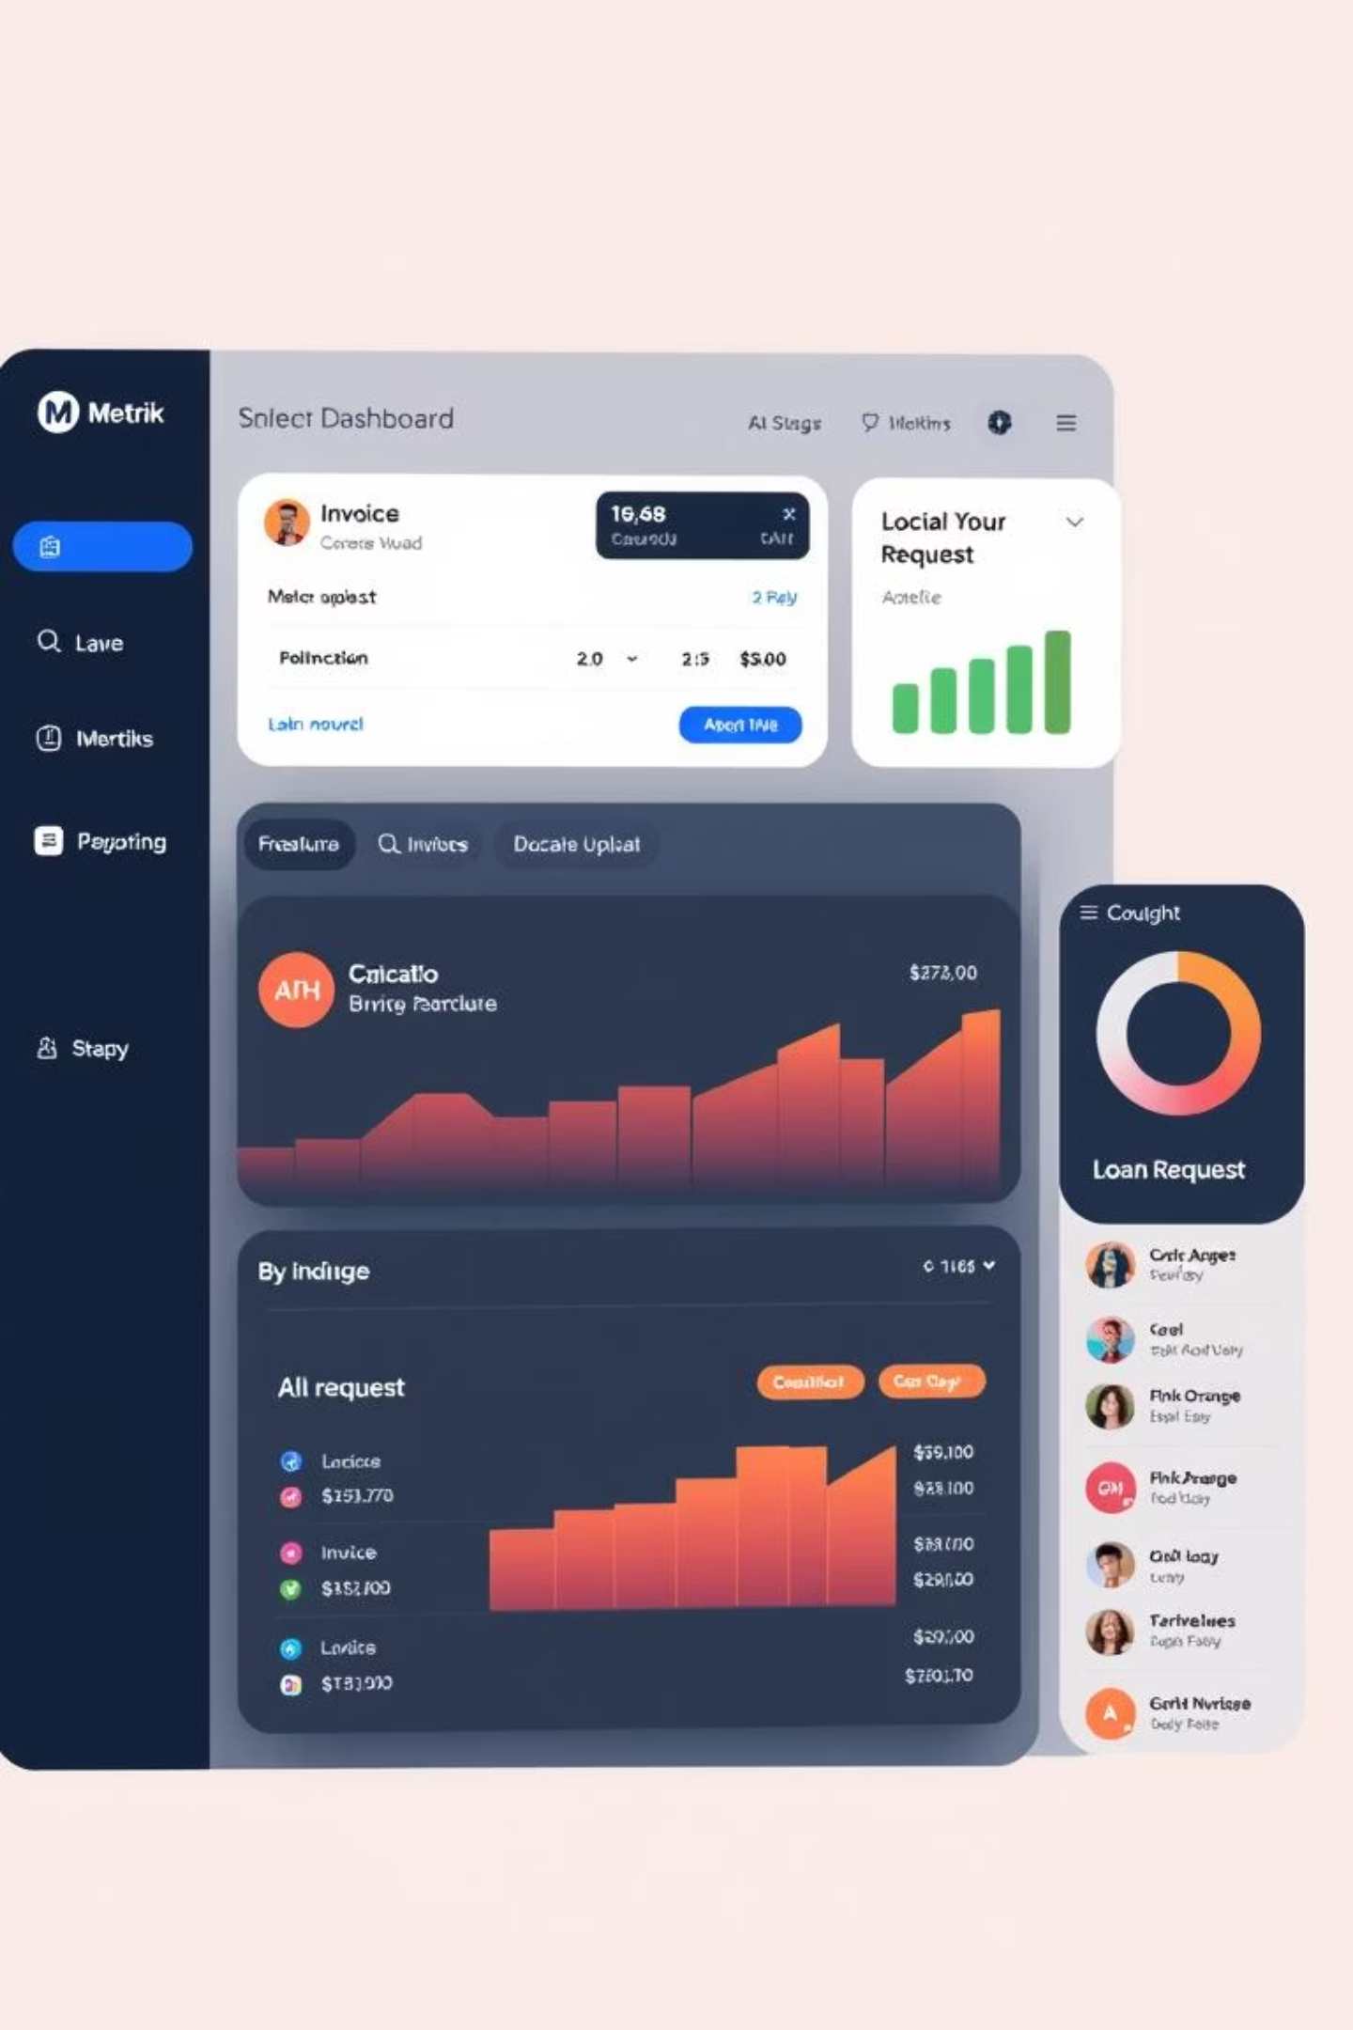
Product Interface: Intuitive & Powerful
Our platform features an intuitive dashboard for both suppliers and liquidity providers.
Supplier Dashboard
LP Portal
Upload invoices, track loan status, manage repayments.
View available pools, stake crypto, monitor returns.
Smart Contract Integration
Seamlessly interact with underlying blockchain protocols.

Slide 7


METRIK Token Utility
Staking: Lock METRIK tokens to earn rewards and participate in governance.
Tiered Access: Unlock higher APY rates and exclusive features based on METRIK holdings.
Liquidity Incentives: Provide liquidity to earn additional METRIK tokens.

Slide 8
Tiered Membership Model
Diamond Tier
1
Highest APY, lowest fees, priority access to new pools.
Platinum Tier
2
Enhanced APY, reduced fees, early access to features.
Gold Tier
3
Improved APY, standard fees, regular access.
Bronze Tier
4
Standard APY, base fees, foundational access.
Our tiered model incentivizes long-term METRIK token holding and deeper engagement with the platform, rewarding our most dedicated users and liquidity providers.

Slide 9






Key Features
Invoice NFTs
Direct BTC Lending
Backed by real trade receivables, creating verifiable assets.
Borrow BTC directly, eliminating stablecoin dependency.
Dynamic Trust Scoring
On-Chain Verification
LTV and trust scores driven by staking and credit history.
Optional verification via EigenLayer AVS for added security.
BTC Yield Generation
Decentralized Credit
For BTC holders seeking yield in a real-world use case.
No centralized underwriters, no traditional credit bureaus.

Slide 10




Who It's For
Vendors
Bitcoin Holders
Businesses needing instant capital against outstanding invoices, unlocking trapped liquidity for operational growth.
Individuals and institutions seeking secure, low-risk yield by leveraging their BTC in real-world asset financing.
DAOs & Protocols
DeFi Protocols
Decentralized autonomous organizations and Bitcoin protocols aiming to expand into real-world asset financing and support.
Innovative DeFi platforms looking to integrate BTC-backed primitives, enhancing their ecosystem offerings and utility.

Slide 11
Sustainable Business Model & Revenue Streams
Revenue Generation
Token Viability
Origination fees collected from borrowers.
METRIK token demand is inherently driven by:
Optional withdrawal or early exit fees from LPs.
Growing borrowing capacity within the ecosystem.
Revenue driven by METRIK token utility, including staking tiers.
Attractive staking tiers offering enhanced platform benefits.
Incentivizing LP reward mechanisms for liquidity providers.
Fee Allocation
A portion directed towards insurance premiums for risk mitigation.
Contributions to a robust reserve pool for stability.
Funds allocated to the protocol treasury and governance initiatives.

Slide 12








Metrik's Sustainable Ecosystem Flywheel
Verified Borrowers
Secure LP Returns
Rigorous on-chain and off-chain vetting ensures creditworthiness, enabling low-risk invoice financing for lenders.
Invoice-backed loans and robust risk mitigation strategies drive reliable, attractive yields for liquidity providers.
Enhanced Borrowing
Increased Liquidity
Deeper liquidity provides faster approvals, more flexible terms, and competitive rates for vendors seeking capital.
Consistent, secure returns attract more LPs, significantly expanding the platform's overall lending capacity.

Slide 13





Real-World Impact & Path to Scale
Target Users
Scalable by Design
Cross-Market Potential
Empowering startups, SMEs, and working capital-constrained exporters/importers with vital liquidity.
Leveraging NFT-based loans and automated credit scoring for efficient, rapid expansion.
Expanding into regions with high SME credit gaps and multi-chain for broad liquidity sourcing.
Compliance-First
Long-Term Vision
Robust KYB and legal contract layers ensure regulatory adherence and secure growth.
Building the foundational DeFi credit layer for real businesses and global trade.

Slide 14

Lets do the Hard Talk, we are providing Undercollateralized Loans which comes with great risk.

Slide 15

But we aren't Idiot, we thought about it.

Slide 16

What Happens When Borrowers Default?
Invoice NFTs
KYB & Legal Contracts
Verifiable, expirable NFTs serve as primary loan collateral.
Borrowers undergo KYB and sign off-chain legal agreements.
METRIK Token Slashing
Borrowing Capacity
Staked METRIK is slashed upon default, disincentivizing non-payment.
Loan limits based on METRIK stake and repayment history.
Reserve & Insurance
A reserve pool and insurance premiums mitigate systemic risk.

Slide 17

What If LPs Want to Exit?
Two Options:
Flexible (Junior Tranche): Withdraw anytime, high APY.
Fixed (Senior Tranche): Locked capital, stable APY.
Both earn METRIK tokens based on time and amount.

Slide 18
Key Differentiators
How Metrik Is Different from other De-Fi Loan Providers?
Real businesses, not just on-chain entities
Invoice-backed lending
Pre-approved borrowers
Legal contracts enforceable off-chain
Borrowing limits are calculated, not fixed
Insurance + Reserve protection

Slide 19




Preventing Fake Invoices
Third-Party & Buyer Verification
Zero-Knowledge Privacy
Rigorous verification processes by independent third parties and direct buyers ensure invoice authenticity.
Utilizing Zk-proofs, we verify invoice validity without compromising sensitive business data, enhancing privacy.
On-Chain Credit Scoring
Legal & Platform Sanctions
Borrower credit scores are tracked transparently on-chain, providing real-time risk assessment and reliability data.
Bad actors face severe legal penalties and are permanently banned from the platform, deterring fraud effectively.

Slide 20



Limited Risk Buffer — Metrik’s Mitigation
Borrower Staked METRIK
Insurance Premium Allocation
Emergency Reserve Pool
Borrowers stake METRIK tokens as primary collateral, aligning incentives and reducing the likelihood of default.
A dedicated reserve pool is maintained to cover emergency losses, acting as a final line of defense for the entire ecosystem.
A portion of Metrik's protocol revenue is allocated to an insurance premium, providing a robust buffer against unforeseen losses.

Slide 21
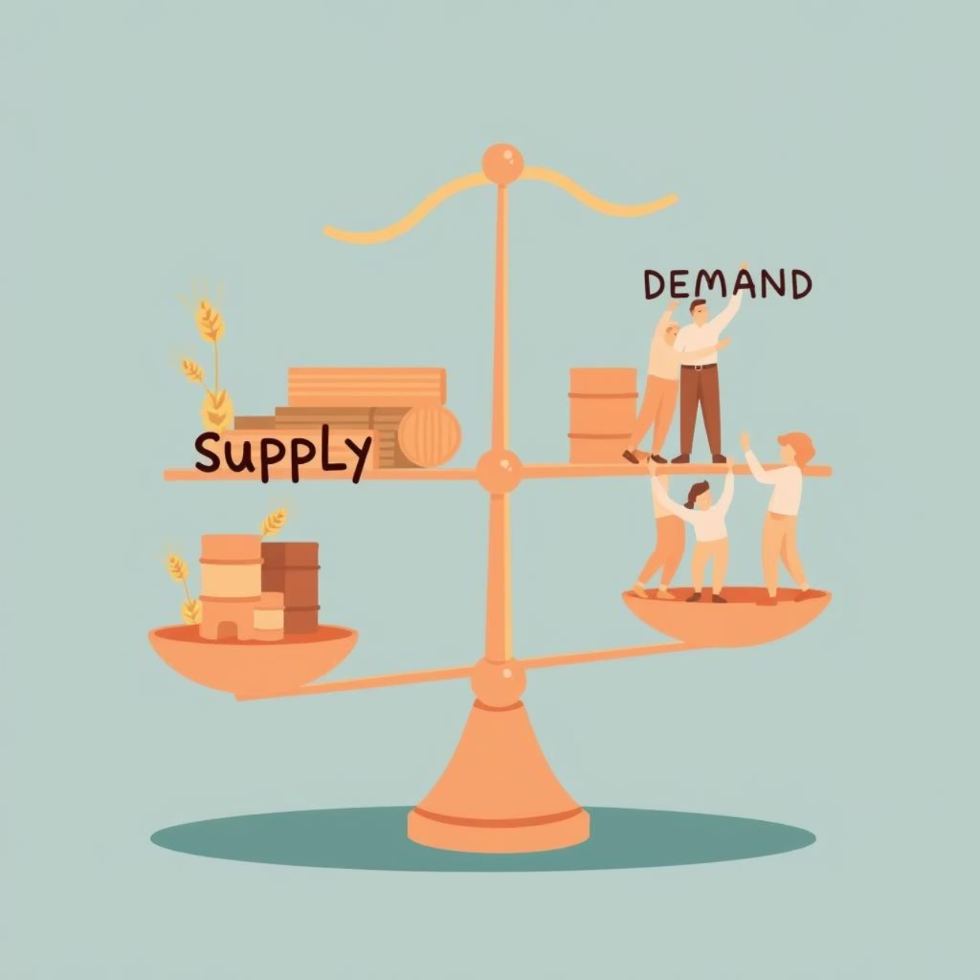
Go-to-Market Strategy
Liquidity Supply
Internal capital and investor LP participation
Strategic METRIK incentives for early liquidity providers
Borrower Demand
Direct B2B outreach to growing businesses
Onboarding of verified SMEs and innovative startups

Slide 22

Next Steps:
Invest: Capitalize on the future of supply chain finance.
Partner: Collaborate to expand market reach and integrate solutions.
Connect: Reach out for a detailed demo and discussion.

Slide 23


Thank You
We appreciate you taking the time to learn about Metrik. We are excited about the future of decentralized finance and supply chain liquidity.

